Slide 1
INNOVATOR OF RECORD
2016

Slide 2
YOU STILL
HAVE TIME TO LEAVE !

Slide 3
An industry being disrupted.
Agencies Shift Into Consulting Role - and Gain New Business
“Our traditional target is the CMO – now it’s moving toward the CIO …
“clients want better coordination between IT and marketing… between their Chief Information Officers and Chief Marketing Officers.
“the move into information technology will require a rethink of strategy, to build those capabilities into our present offering”
Sir Martin Sorrell
Notes:
Agencies becoming strategic consulting cos.
With huge new component of data and technology inserted in the equation.
Have to rethink their strategy and bring new capabilities to their offering

Slide 4
An industry being disrupted.
"I am convinced that existing ways of agencies and holding companies have to come to an end,"
"We must invent new strategies and new ways of doing business."
“…the company will no longer be called a holding company, but a Connecting Company, because the holding company model, is dead and gone.
March 2016 4A's Transformation Conference
Publicis Groupe CEO & Chairman, Maurice Lévy

Slide 5
An industry being disrupted.
Will business consulting companies become a threat to agencies?
Consulting cos. are building in-house digital practices, offering a full suite of marketing services.
PwC, McKinsey, Accenture, Deloitte are taking agency and design responsibilities through mergers and acquisitions.
Ad Age‘s agency list categorized Deloitte Digital, Accenture Interactive, PwC Digital as networks similar to WPP and Publicis Groupe.
Notes:
Business consulting companies such as PWC, McKinsey, Accenture, Deloitte adding advertising and marketing deliveries>>>becoming agencies
Even Ad Age categorizes them already.

Slide 6
“Size of the prize of future digital business means it is inevitable the two (traditional) business models of AGENCY and CONSULTANCY will COLLIDE.
Damian Burns, Director of Global Agency Sales, Google

Slide 7
Can Indie Ad Agencies Thrive in the New Era?
Nimble and tech-savvy shops dodge both acquisition and bankruptcy

Slide 8
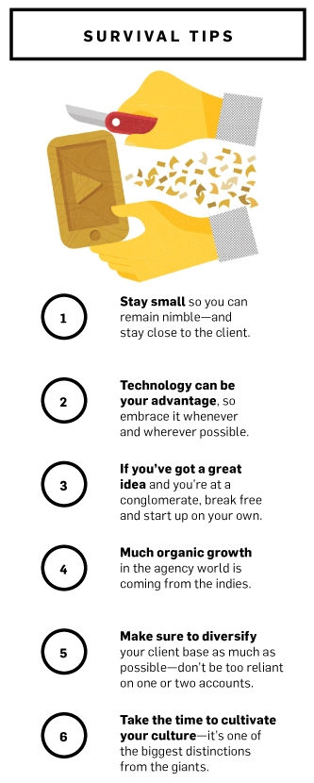
Technology can be your advantage
So embrace it whenever possible
Notes:
Out of the survival tips according to ADWEEK, technology is 2nd

Slide 9
HOW TECHNOLOGY IS SHAPING THE FUTURE OF MARKETING

Slide 10
TECHNOLOGY IS SHAPING THE FUTURE OF MARKETING

Slide 11
The Wild West Of Digital Advertising
“mommy blogs compete with Condé Nast for ad dollars
“Candy Crush app can make as much money as CNN (campaign).
“the ad tech sector is dense, complicated, and poorly understood (even by people who work in the industry) LUMA Partners
Mobile Ad Spend to Top $100 Billion Worldwide in 2016,
51% of Digital Market ($ 198 Billion)

Slide 12
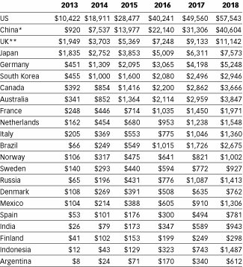
Mobile Internet Ad Spending Worldwide, by Country, 2013-2018 ($ millions)
Notes:
Brasil: 12th in 2016
9th in 2017
7th in 2018

Slide 13
5bn people with Smartphones (2020)
Notes:
More than 2 billion smartphone users worldwide (2016)
7.2 billion population
Aprox 1.5bn tvs

Slide 14
Notes:
App in the market for 6 months

Slide 15
Digital

Slide 16
DURING THE GOLD RUSH, MOST WOULD-BE MINERS LOST MONEY, BUT PEOPLE WHO SOLD THEM PICKS, SHOVELS, TENTS AND BLUE-JEANS (LEVI STRAUSS) MADE A NICE PROFIT.
Peter Lynch

Slide 18
Innovation Philosophy
Innovation
70% Optimizing Today
Today’s revenue
(pay the rent)
Low-risk, high success probability Executed efficiently
20% New ‘Best’ Practices
New revenue & growth
Moderate durability and impact
(new products, new techniques, etc.)
10% Experimentation
Game changing ideas.
Risky but huge potential Completely change the game Win big.

Slide 19
Strategy
Creativity
Technology
Notes:
So you’ve told me that technology is important for brands and agencies. ok

Slide 20
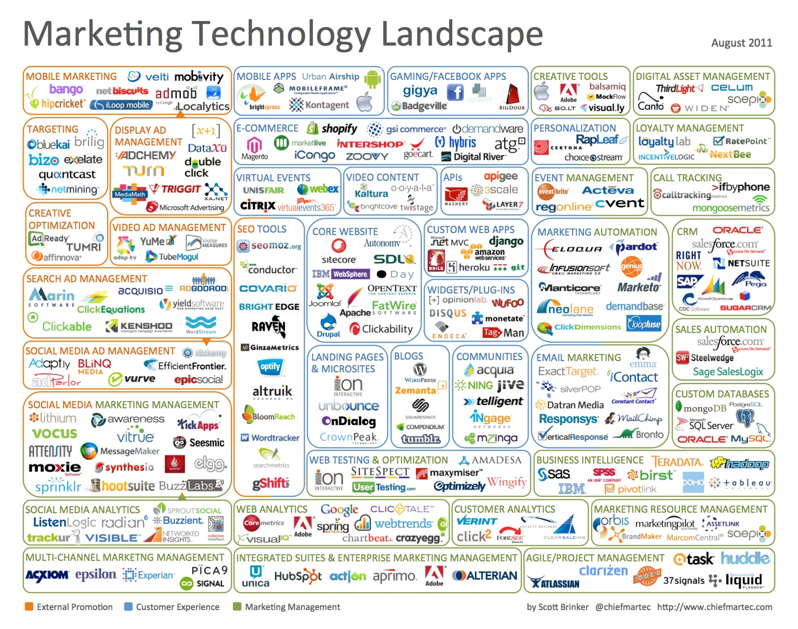
Notes:
So that easy for agencies to plug in technology?

Slide 21
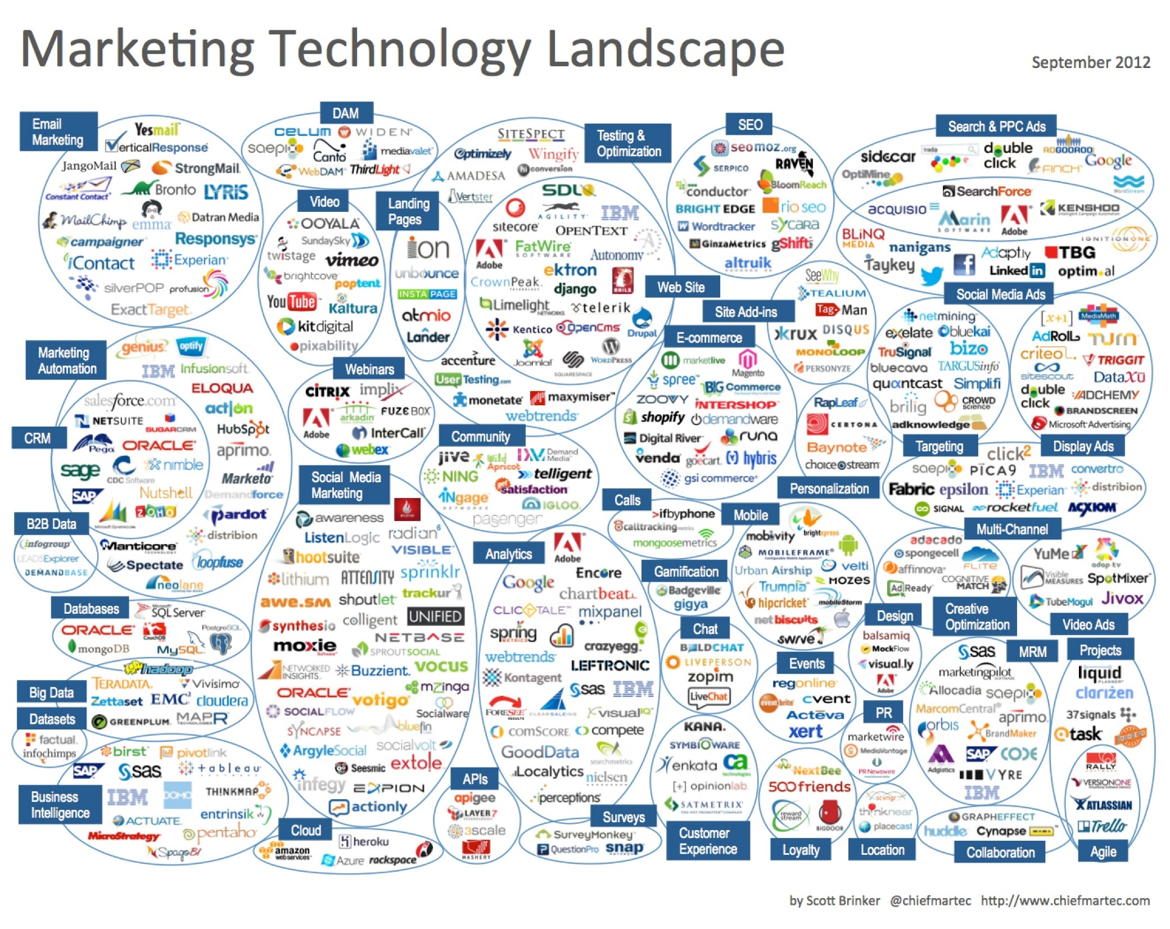
Notes:
So that easy for agencies to plug in technology?

Slide 22
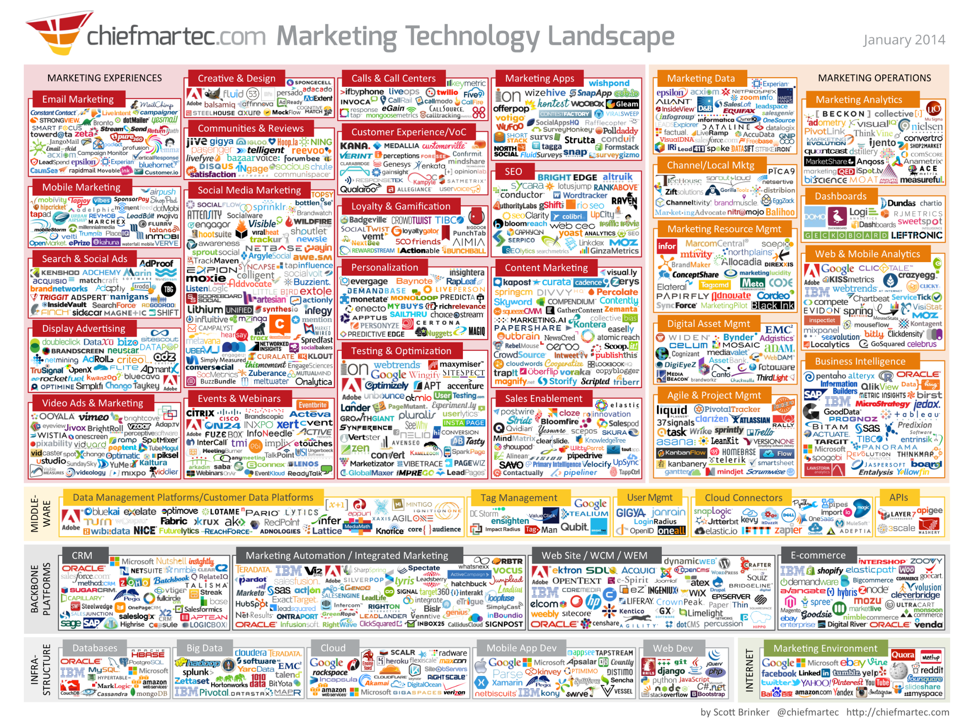
Notes:
So that easy for agencies to plug in technology?

Slide 23
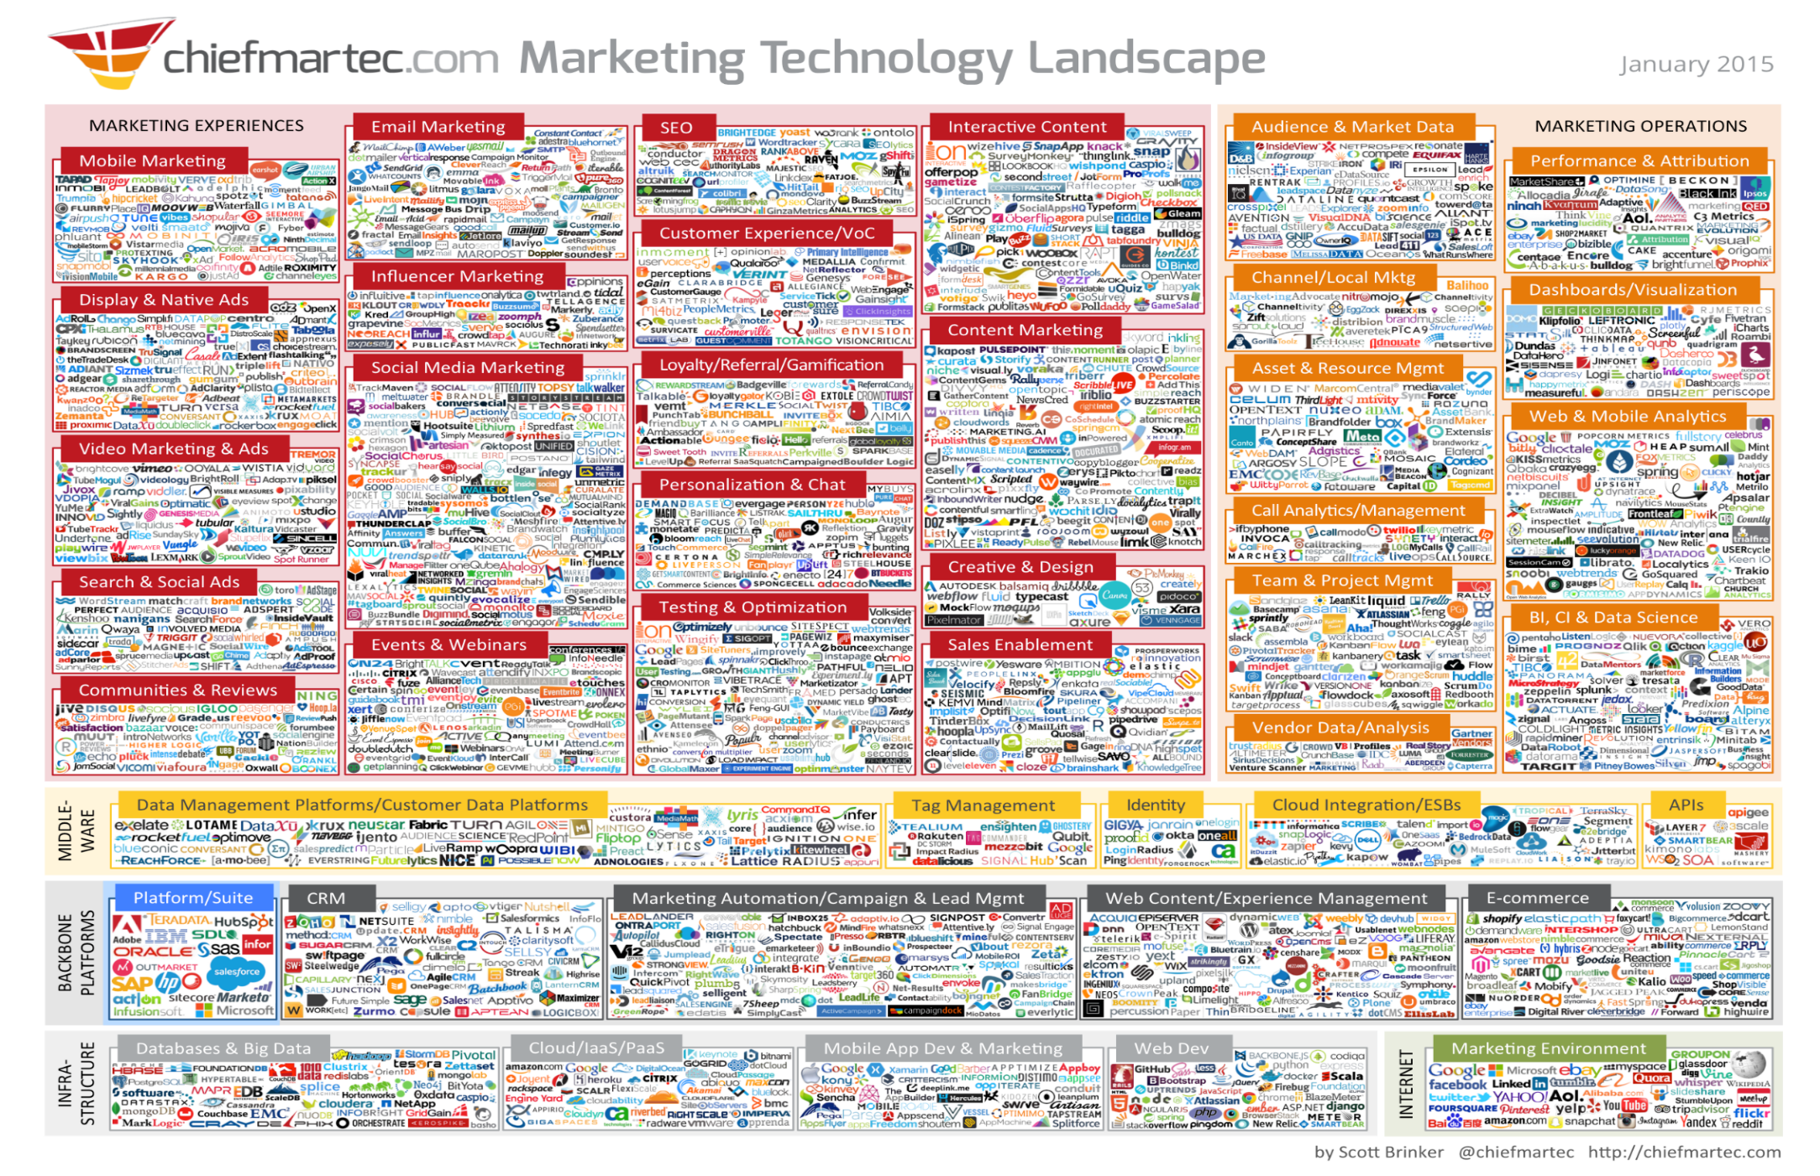
Notes:
So that easy for agencies to plug in technology?

Slide 24
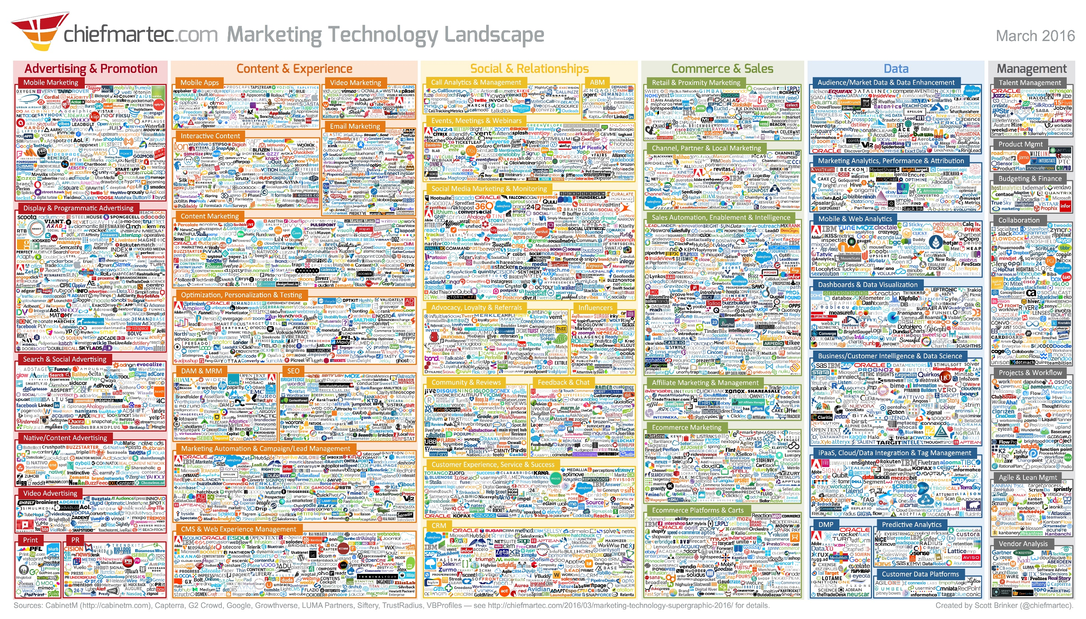
Notes:
So that easy for agencies to plug in technology?

Slide 25
2014: 947 ad tech companies (U.S)
2015: 1,876 companies, 43 categories
More than 4000 marketing technology companies worldwide
New categories keep emerging sometimes rebellious offshoots from previous categories
“Influencer Marketing” separate from “Social Media Marketing”
http://chiefmartec.com/

Slide 26
The average global marketer uses 26 different tech suppliers for its digital media.
The problem is the audience is shifting so rapidly
2015 worldwide spend for marketing software: $22.6 billion
By 2018: $32.3 billion.
Notes:
We believe there is a waste happening

Slide 27
TALK TO YOUR DOCTOR BEFORE CONSIDERING MARKETING TECHNOLOGY …

Slide 28
MORE THAN A THIRD OF BRANDS WORK WITH STARTUPS
(February 2, 2016)
Social Media, Content development, Mobile advertising…
Marketers engage with startups to:
leverage new technology,
stay ahead of trends,
drive innovation,
gain competitive advantage at a reasonable cost.
Notes:
So some good news

Slide 29
MORE THAN A THIRD OF BRANDS WORK WITH STARTUPS
(February 2, 2016)
88% of Companies that engage startups do so within existing marketing budgets.
53% work with their agencies to help them partner with startups.
Biggest barrier to engagement is the startup’s inability to articulately describe its offering in a meaningful and relevant manner.
Respondents indicated they are not buying technology — rather, they’re buying solutions to business problems.
Notes:
53% - this number will probably grow. Why?
They don’t understand the techies
Look at the parallel with the consultancy cos

Slide 30
BRANDS AND AGENCIES HAVE A VERY HARD TIME KEEPING UP.
IT’S A FULL TIME JOB!
Notes:
Very tough to be an agency nowadays

Slide 31
THEIR JOB IS TYPICALLY TO MANAGE THE CURRENT BUSINESS WITH PROVEN TECHNIQUES.
THEY DON’T HAVE TIME TO KEEP UP WITH THE CHANGES.
OR TO KNOW WHEN TO STRAY FROM THE APPROACHES THEY HAVE MASTERY OF.

Slide 32
Agency
Consulting Cos.
Holding Cos.
Clients
Strategy
Ad Technology
Creative

Slide 33
Right (Adtech) tools for the right job
Notes:
Simplify technology choices

Slide 34
NEW BUSINESS

Slide 35
Conducts deep market and industry analysis.
Identifies major challenges and pain points of Brands and Agencies.
Independently screens global market trends in Digital Advertising & Marketing.
Detects new innovative shifts and technological advances.
Notes:
Tech innovation source

Slide 36
Selects and curates the best innovative, state of the art AdTech companies.
Conceives, designs and engineers. the combination of technologies according to identified pain points.
Bundles technologies , producing comprehensive, result focused, problem solving, technology solutions.
Notes:
Enable agency to become a digital innovator
Competitive edge

Slide 37
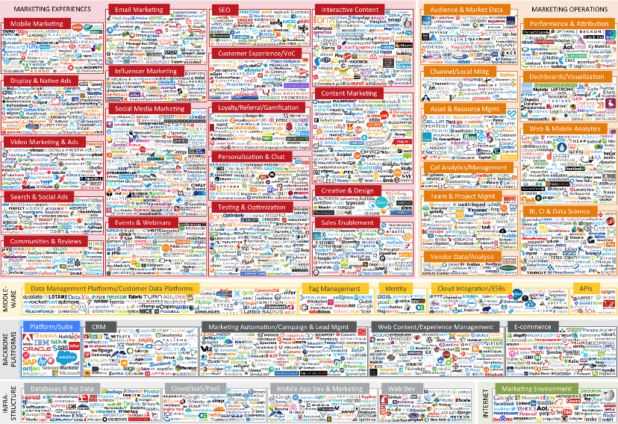
Notes:
With the agencies creative and strategy>>ads a clear differential

Slide 38
The Traditional Way
AGENCY OF RECORD
70% Optimizing Today
Today’s revenue
(pay the rent)
Low-risk, high success probability Executed efficiently
Notes:
Change of goals for the agency. From the AOR

Slide 39
Innovation
INOVATOR OF RECORD
20% New ‘Best’ Practices
10% Experimentation
Notes:
This new company should help them be the innovator of record

Slide 40
Cases
Agency (and Brand) Pain Points

Slide 41
1- Cosmetic & Perfume Retailer: How to drastically increase online sales (and measure it).
- Programmatic Media using Agile Audience Targeting method
- Dynamic Creative Programmatic: the right creative for the right consumers.
- Insta–Commerce: Shoppable Ads improving customer experience and reducing bounce rates.
Notes:
3 technologies bundled together.
1 delivery
4x conversion
52% decrease in CPA

Slide 42
2- Young fashion Brand: How to target teenagers (video campaign)
-Video Content Crowdsourcing: it's crowd-culture!
-Programmatic Media (video) using Agile Audience Targeting method
-Dynamic Personalized Video: super customized messages
-In-app video advertising: reaching customers in video games
+ - Social Media Loyalty: rewarding customers for social behavior
- Influencer Marketplace: finding the right influencers using math, not guessing.

Slide 43
3- How to increase Publisher’s revenues?
- Anti-fraud: Cleaning inventory from bots, increasing CPM
- Audience Extension: giving a broader reach to their own audience
- Text to Video: innovation for cheap content creation

Slide 44
THANKS
DEMIAN WALDMAN

