Slide 1
The holding company disruptors

Slide 2
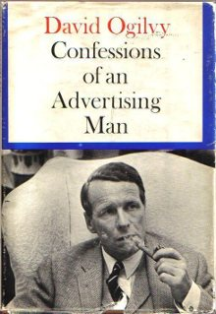

Slide 3
Today, there is disruption nearly everywhere.
Except one place…

Slide 4
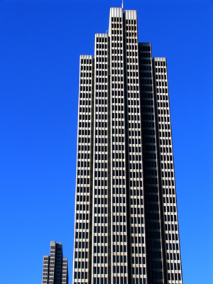
Holding Company, Inc.

Slide 5
Only 10 of the 37 highest paid ad executives are “practitioners” who add value to clients
RANK | NAME | COMPANY | SALARY
1 | Martin Sorrell | WPP Group (CEO) | $27mm
2 | Maurice Levy | Publicis Group (CEO) | $24.4mm
3 | John Wren | Omnicom (CEO) | $14.8mm
4 | Paul Richardson | WPP (Finance Director) | $12.4mm
5 | Randall Weisenburger | Omnicom (CFO) | $10.6mm
6 | Michael Roth | Interpublic Group (CEO) | $9.7mm
7 | Miles Nadal | MDC Partners (CEO) | $9.3mm
8 | Alan Herrick | Sapient (CEO) | $6mm
9 | Kevin Roberts | Saatchi & Saatchi (CEO) | $4.5mm
10 | Alfonso Rodés Castañe | Havas Worldwide (Global Media CEO) | $4.2mm
11 | David Jones | Havas Worldwide (CEO) | $4mm
12 | Frank Mergenthaler | Interpublic (CFO) | $3.8mm
13 | Mark Read | WPP Digital (CEO) | $3.4mm
14 | Philippe Krakowsky | Interpublic Group (EVP/ Strategy & Talent Officer) | $3.3mm
15 | Jack Klues | Vivaki (CEO) | $3.1mm
16 | Vincent Bollore | Havas Worldwide (Chairman of the Board) | $2.3mm
17 | Mercedes Erra | Havas (Board Member/ Founder of BETC Euro RSCG) | $2.2mm
18 | Philip Angelastro | Omnicom (SVP Finance) | $2.1mm
19 | Christian Overshohl | SapientNitro (Managing Director Asia Pacific) | $2.1mm
RANK | NAME | COMPANY | SALARY
20 | Andrew Bonzani | Interpublic (Senior VP General Counsel & Secretary) | $2.1mm
21 | Jean- Yves Naouri | Publicis (COO) | $2mm
22 | Alan Wexler | SapientNitro (Managing Director North America & Europe) | $1.7mm
23 | Michael O’Brien | Omnicom (General Counsel) | $1.7mm
24 | Joseph Tibbetts | Sapient (CFO) | $1.5mm
25 | Léopoldo Rodés Castañe | Havas (Board Member) | $1.5mm
26 | Harry Register | Sapient Global Markets (Managing Director) | $1.3mm
27 | Christopher Carroll | Interpublic Group (SVP Controller/ Chief Accounting Officer | $1.2mm
28 | Jacques Séguéla | Havas Worldwide (Chief Creative Officer) | $1.2mm
29 | Dennis Hewitt | Omnicom (Treasurer) | $1.2mm
30 | Jean-Michael Etienne | Publicis (CFO) | $1.2mm
31 | Jean de Yturbe | Havasworldwide (Chief Development Officer) | $875k
32 | Stephen Pustil | MDC Partners (Vice Chairman) | $873k
33 | Michael Sabatino | MDC Partners (Chief Accounting Officer) | $826k
34 | Mitchell Gendel | MDC Partners (General Counsel) | $810k
35 | Herve Philippe | Havas Worldwide (CFO) | $763k
36 | David Bolt | MDC Partners (CFO) | $714k
37 | Yannik Ballore | Havas Worldwide (Managing Director/ Deputy CEO) | $544k

Slide 6
The Score
Shareholders | 27
Clients | 10

Slide 7
The real issue for agencies: A 25 year downward spiral
Lower fees
Lower talent
Lower value

Slide 8
We haven’t helped ourselves
Agencies
Keep clients
Make numbers
Do what’s asked
Consultants
Deliver value
Measurable results
Lead Clients

Slide 9
The coffee bean problem

Slide 16
The procurement - marketers gap
Deliverables
Increasing 2.3% every year due to need for more digital content
Fees
Decreasing 2.2% every year due to pressure from procurement
*Data provided by Michael Farmer,
Ex- Bain Consultant

Slide 17
The real impact is on talent
Procurement
Wall Street
Cheat
Reduce Quality

Slide 18
The talent drain
STARTING SALARIES
Agencies | $35,000
Google, Facebook, Twitter | $65,000 + signing/ year end bonus guaranteed
SALARY MULTIPLES
Agencies | 2.2 - 2.4x
Consulting | 4 - 6x
(Both go through procurement)

Slide 19
70% of agency talent is looking for a job
Therefore… only 3 out of 10 are NOT checked out

Slide 20
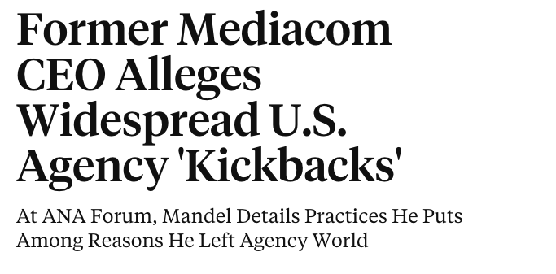

Slide 21
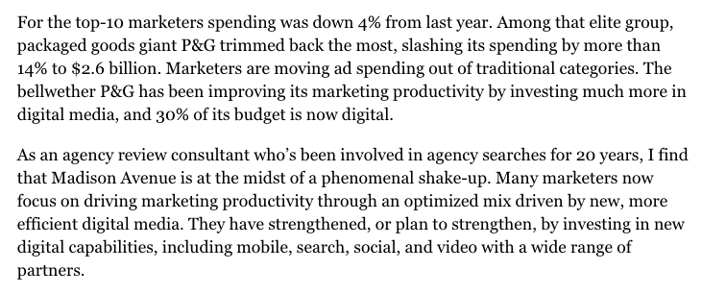

Slide 22
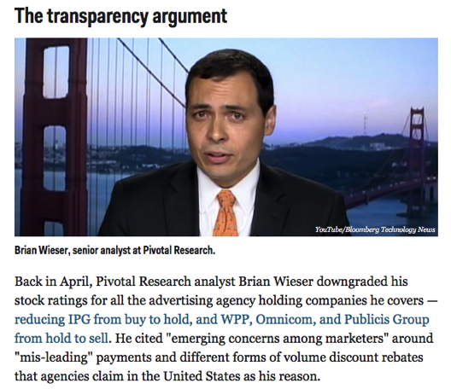

Slide 23
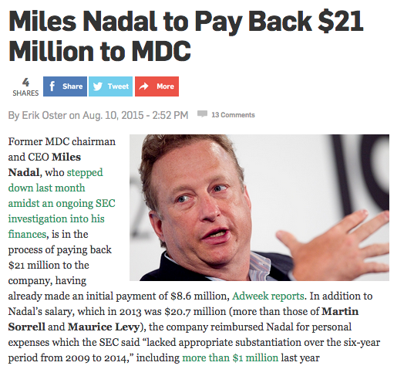

Slide 24
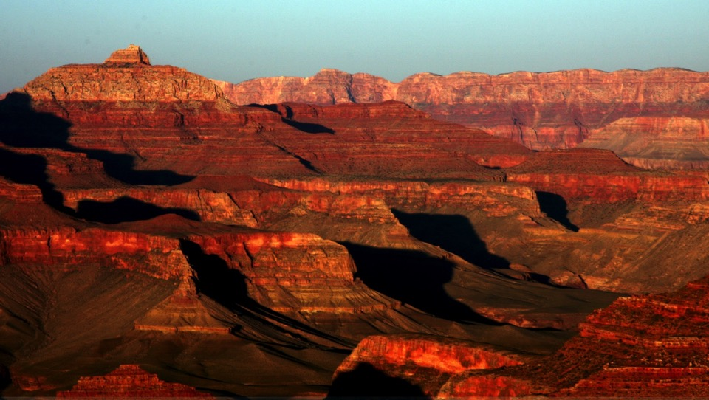
Only a new model can close the gap
Procurement
Marketers

Slide 25
Who are the heirs to the throne?
AdLand

Slide 26
1. Managing marketing complexity: the marketing systems integrator

Slide 27
2. Tech stack of record (TOR) replaces agency of record (AOR) as the foundation
PROGRAMMATIC MEDIA
CONTENT + SOCIAL
DATA + ANALYTICS
LEAD MANAGEMENT

Slide 28
3. One more idea… Talent
Traditional holding companies aggregated
agencies @ scale by acquiring them
Is there another way to aggregate talent?

Slide 29
The largest taxi company owns no cars
The largest hotelier owns no hotel rooms
The largest media company owns no content
Now, there’s a global marketing services holding company that owns no agencies

Slide 30
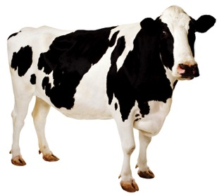
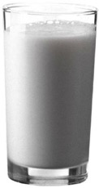
You don’t need to own the cow to enjoy the milk

Slide 31
Traditional vs. “virtual” holding company
Tech Partners
Expensive Freelance
Independent
Agencies
Owned Agencies
Finance +
Big Buildings
Tech
Embedded
Strategy +
Resource
Mgmt
Flex Staff
Crowdsource

Slide 32
The model
You don’t need to make everything yourself
Curate + craft vs. create

Slide 33
“The smartest people in the world don’t work for you”
- Bill Joy

Slide 34
Speaking of talent…

Slide 35
Why are so many people willing to wait tables in Hollywood?

Slide 36
No one dreams of becoming a Hollywood extra

Slide 37
We must fix the compensation structure
FTE
DELIVERABLES
ROI

Slide 38
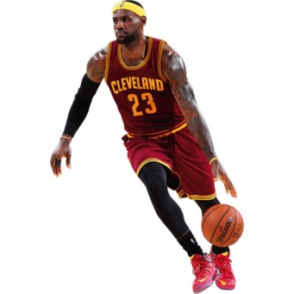
FTE
ROI

Slide 39
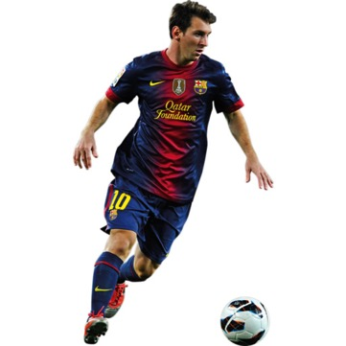
FTE
ROI

Slide 40
FTE
ROI

Slide 41
We must focus on high value delivery
High value delivery
Higher fees
Better talent
100% certainty: The client will not start this process

Slide 42
So where do we get the money?

Slide 44
The future of holding companies is very much in doubt

Slide 45
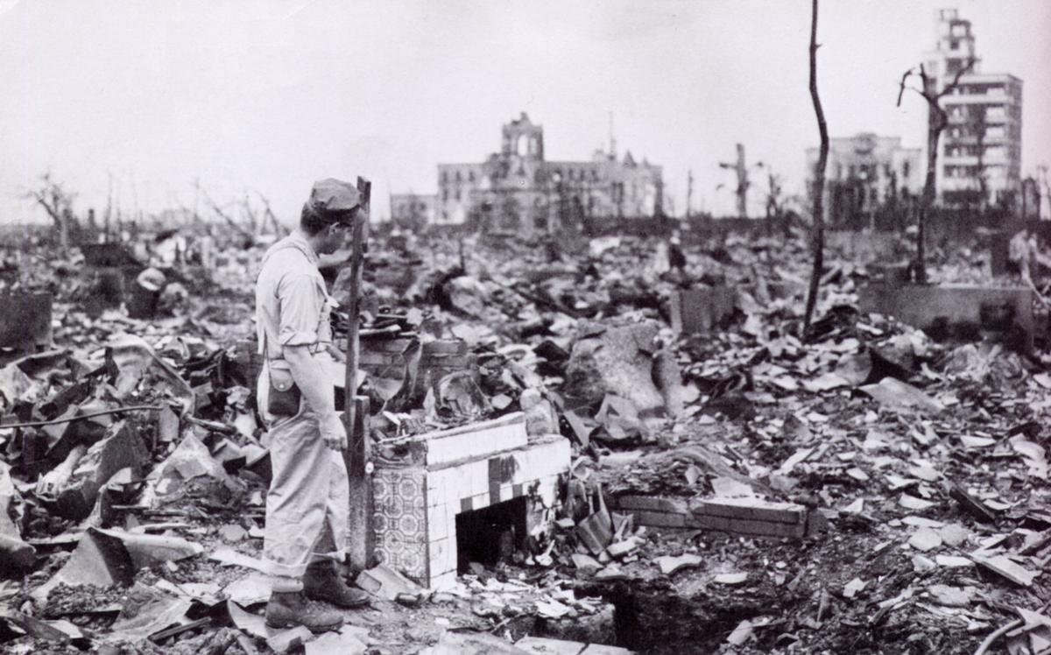
As for agencies…

Slide 46
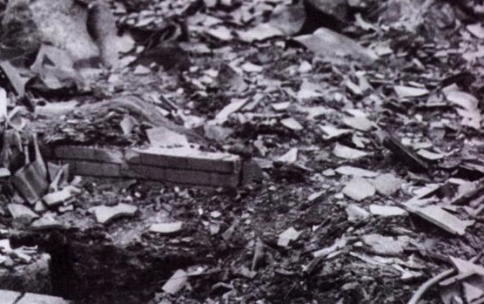
“Agencies are the cockroaches of the business world” -Rishad Tobaccowala

Slide 47
Or, if we can fix it…

Slide 48
