Slide 1
Marketing for good
Adam Gagen, Legal and Public Affairs Director

Slide 2
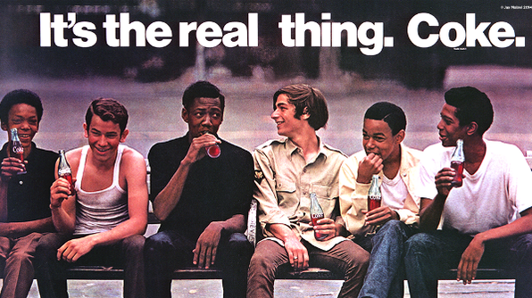
Value of advertising

Slide 3
Value of advertising
$
519
Bln
X 6

Slide 4
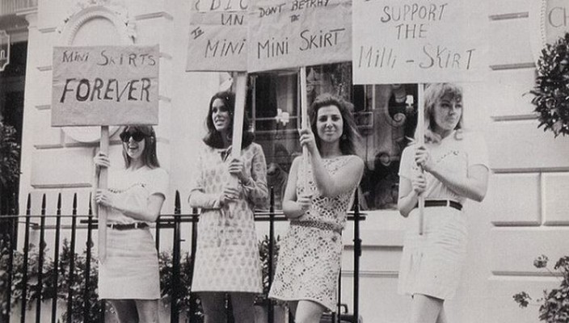
Getting it right
TRUTH
TASTE
DECENCY
Notes:
4

Slide 5
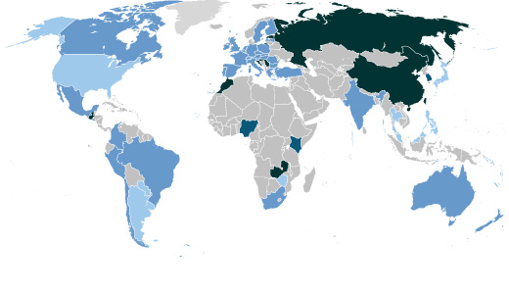
Getting it right
Notes:
5

Slide 6
Old dog, new ‘effective advertising standards’
Alcohol
Consumer
Wellness
Digital
Food
Notes:
6

Slide 7
Old dog, new ‘effective advertising standards’
-88%
Notes:
7

Slide 8
Old dog, new ‘effective advertising standards’
self regulation self regulation self regulation self regulation self regulation
self regulation self regulation self regulation self regulation self regulation
self regulation self regulation self regulation self regulation self regulation
self regulation self regulation self regulation self regulation self regulation
self regulation self regulation self regulation self regulation self regulation
self regulation self regulation self regulation self regulation self regulation
self regulation self regulation self regulation self regulation self regulation
self regulation self regulation self regulation self regulation self regulation
self regulation self regulation self regulation self regulation self regulation
self regulation self regulation self regulation self regulation self regulation
self regulation self regulation self regulation self regulation self regulation
self regulation self regulation self regulation self regulation self regulation
self regulation self regulation self regulation self regulation self regulation
1.9%
Notes:
8

Slide 9
Old dog, new ‘effective advertising standards’
Me diga e eu vou esquecer
Ensina-me e eu vou lembrar
Envolver-me e eu vou aprender
=
Government & Industry & Society
Notes:
9

Slide 10
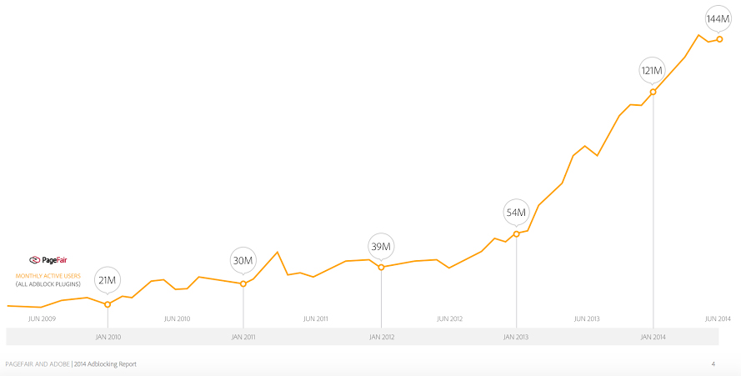
Empowered consumers are here to stay

Slide 11
Marketing for good
PROJECT RECONNECT

